Slide 1

TIME SERIES FORECASTING-CO2 EMISSION LEVEL
PROJECT MENTOR : Mrs.NEHA GUPTA
GROUP MEMBERS:
Mr. Kommareddy Srinivasa Reddy
Mrs.Abirami Rangaraj
Mr.Mallikarjuna Reddy Gurrala
Ms.Simy Mathew

Slide 2
Contents
Business Objective
Project Process Flow
Data Collection and EDA
Level, Trend and Seasonality
Stationarity Check
Model Building-ARIMA
Model Building SARIMA
Model Building –Holt-Winter’s Method
Comparison of Model Performance
Selection of Final Model
Deployment Details
GitHub Links

Slide 3
BUSINESS OBJECTIVE
Given the historical Carbon Dioxide ( CO₂ ) levels, build a Time Series Forecasting Model to predict the future CO₂ levels
Greenhouse gases, especially carbon dioxide (CO₂) emissions are viewed as one of the core causes of climatic change, and it has become one of the most important environmental problems like global warming.
Knowing the level of CO2 emissions by the high emitting organization in near future will provide actionable insights, so that the organization can follow the government norms with respect to Carbon Dioxide emission levels.

Slide 4
PROJECT PROCESS FLOW
Data Collection
Data Pre-processing and EDA
Identify the components of Time Series
Apply various Forecasting methods to identify the best model
Evaluate and compare the results of every applied model
Implement the forecast and develop a system for deployment

Slide 5
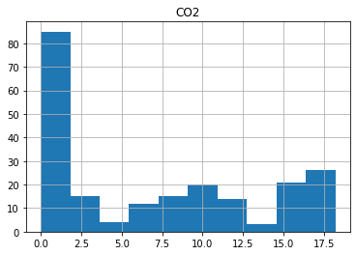
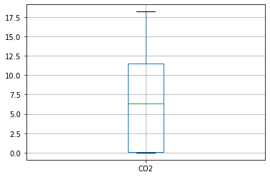
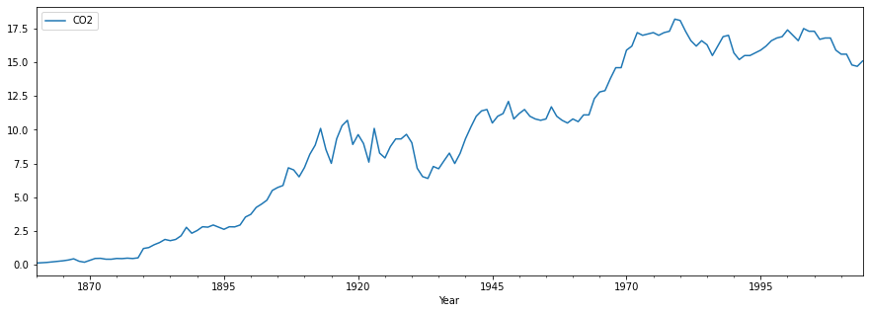
DATA COLLECTION and EDA
Data is not normally distributed
Insights of the dataset:
215 rows & 2 columns
No Null values and duplicate values observed
No outliers detected
Histogram shows a right skewed distribution
Series shows an increasing trend

Slide 6
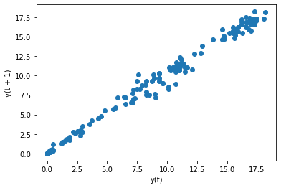
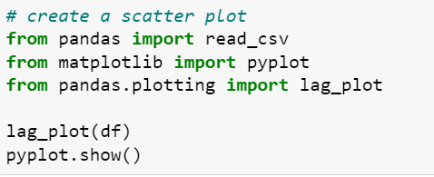
DATA COLLECTION and EDA
Scatter plots are Positively Correlated
Lag plot shows a positive correlation i.e as the year increases
the CO2 emission also increases

Slide 7
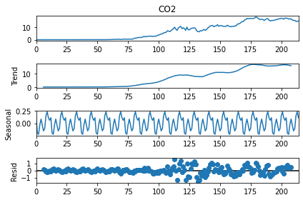
Time Series Decomposition
Trend:
Data shows an increasing trend
Seasonality
Data seems to be seasonal
Residual
There is noise in the data

Slide 8
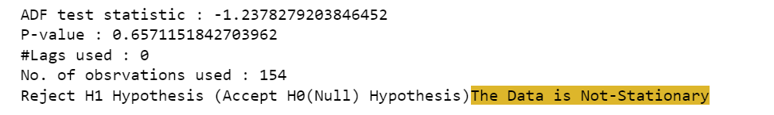
STATIONARITY CHECK-ADF Test
Stationary test using Augmented Dickey Fuller’s Test.
Stationary means the mean and variance of the series remains constant over time
In our case we concluded that the series is non stationary based on ADF Test.
Ho: Data is not stationary
Hi Data is stationary
As Pvalue>alpha we accept Ho i.e Data is not stationary

Slide 9
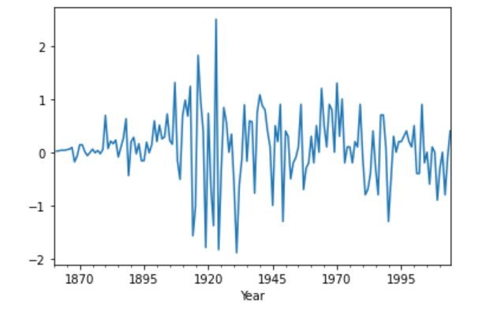
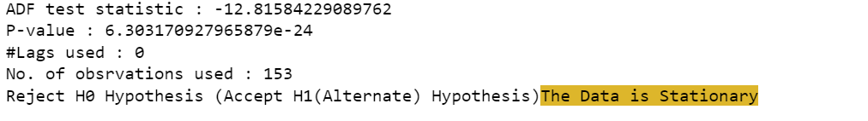
TRANSFORMING NON STATIONARY TO STATIONARY DATA
Using Differencing technique to change non-stationary to stationary data.
This is One of the most common methods of dealing with both trend and seasonality . In this technique, we take the difference of the observation at a particular instant with that at the previous instant. This mostly works well in improving stationarity.
After first order differencing our series was stationary.

Slide 10
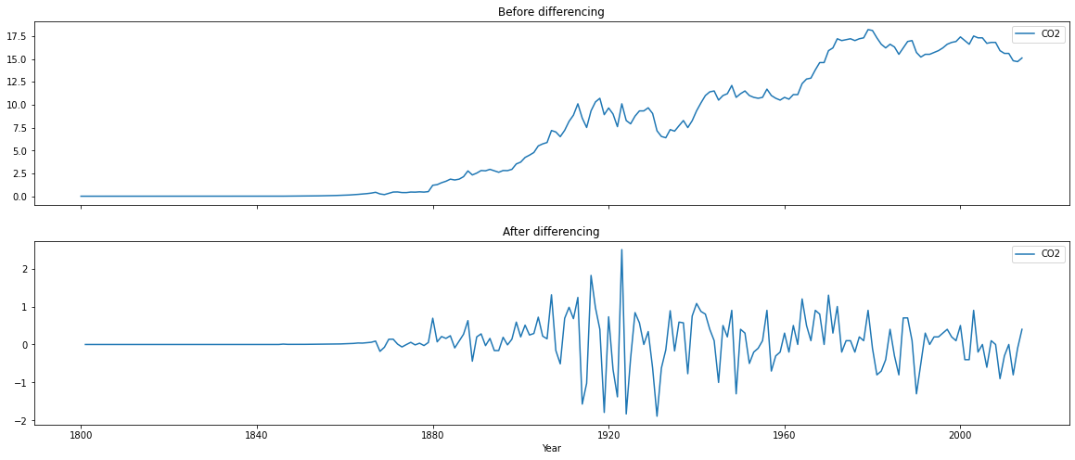
Plots before and after differencing:

Slide 11
MODEL BUILDING
Models used:
ARIMA(Auto Regressive Integrated Moving Average)
SARIMA
Simple Exponential smoothing
Double Exponential smoothing or Holt’s method
Triple Exponential smoothing or Holt’s –Winter method

Slide 12
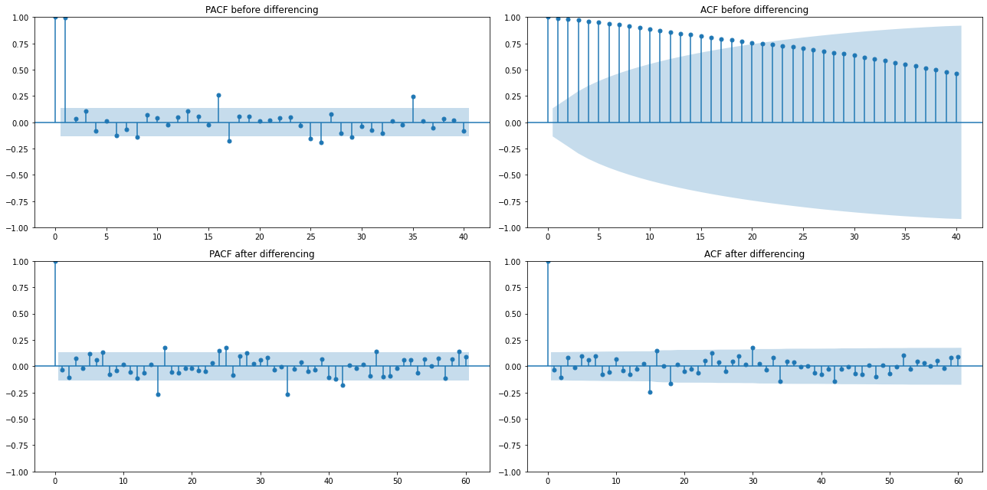
ARIMA Models:
Autocorrelation Function (ACF): It is a measure of the correlation between the time series with a lagged version of itself.
Partial Autocorrelation Function (PACF): This measures the correlation between the time series with a lagged version of itself but after eliminating the variations already explained by the intervening comparisons.
ACF and PACF Plots:

Slide 13
DATA PARTITIONING
Using First Order Differencing data for building model for stationary data because it shows more stationarity.
Training Data = Fit the model only to training period
Validating Data = Assess the model performance on validation
Deploy model by training on whole dataset

Slide 14
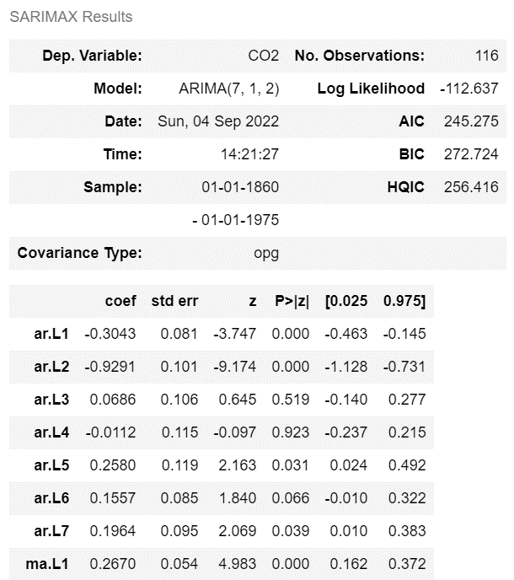
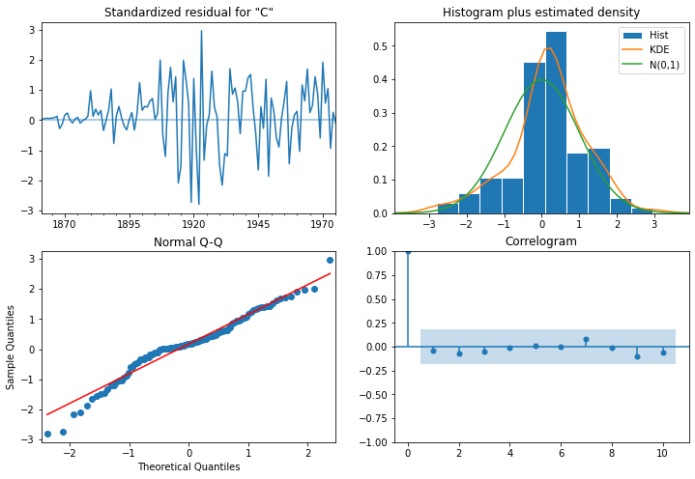
ARIMA(p=7,d=1,q=2)

Slide 15
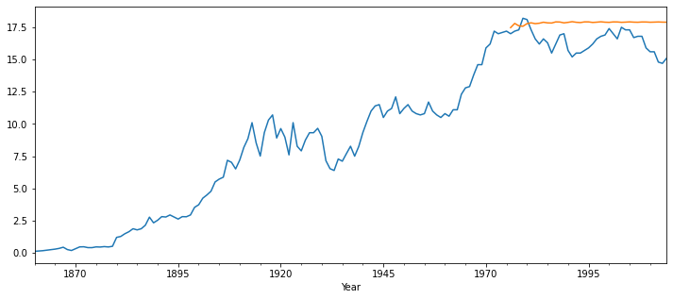

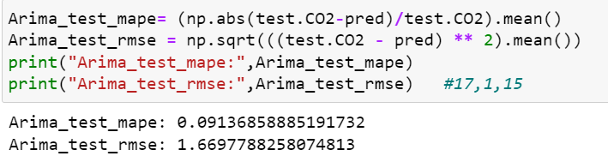
Results from ARIMA (7,1,2)

Slide 16
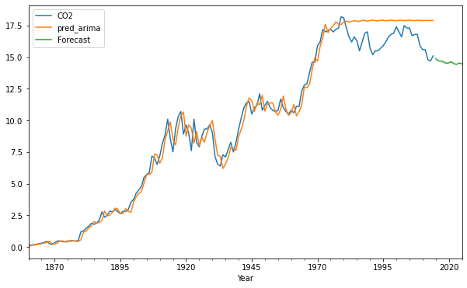
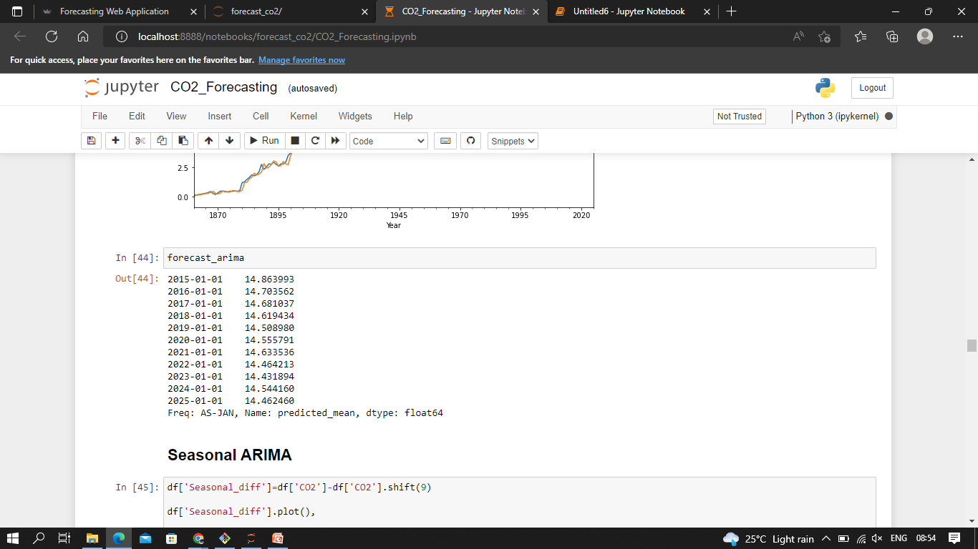
ARIMA(p=7,d=1,q=3)

Slide 17
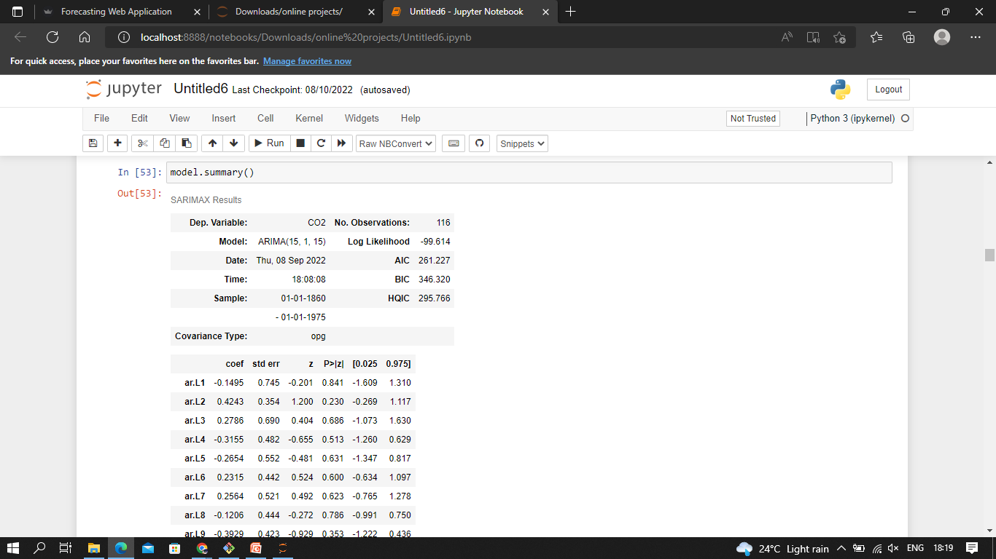
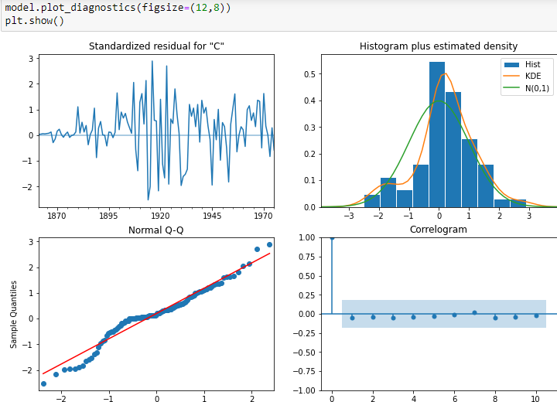
ARIMA(p=15,d=1,q=15)

Slide 18
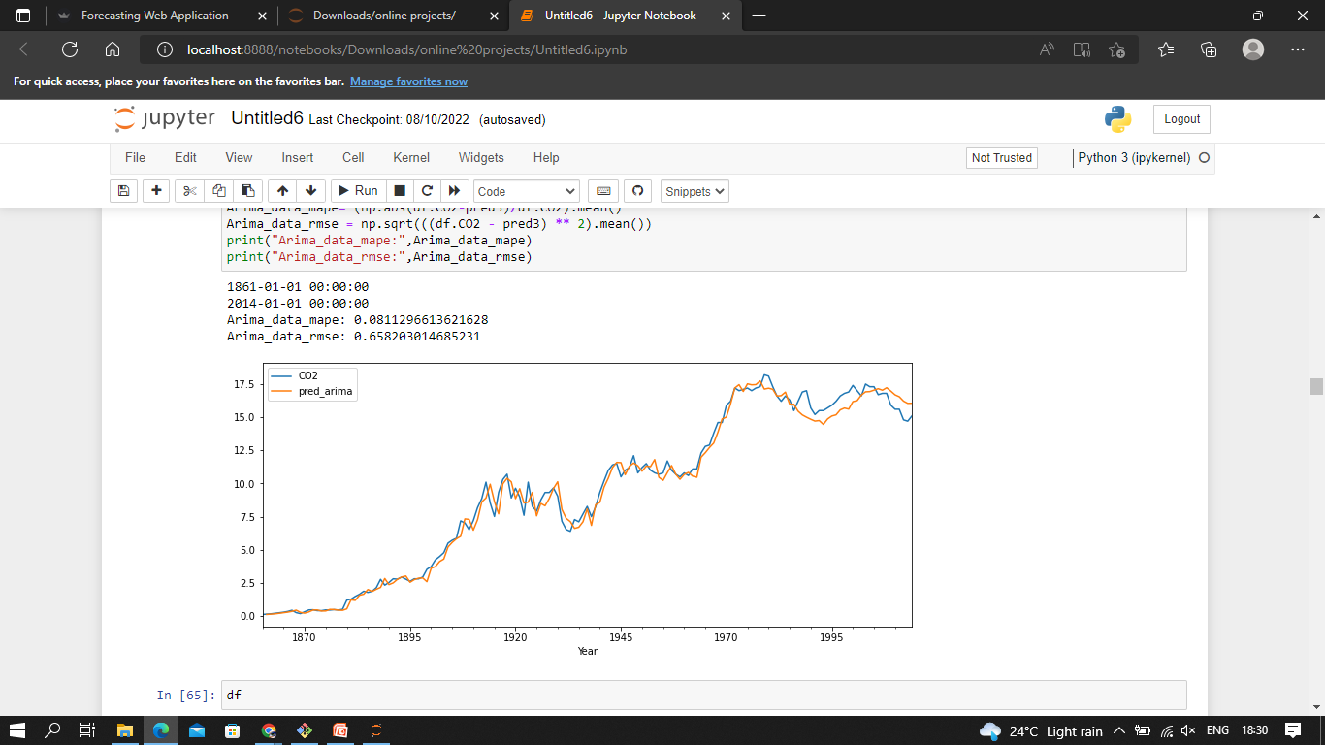
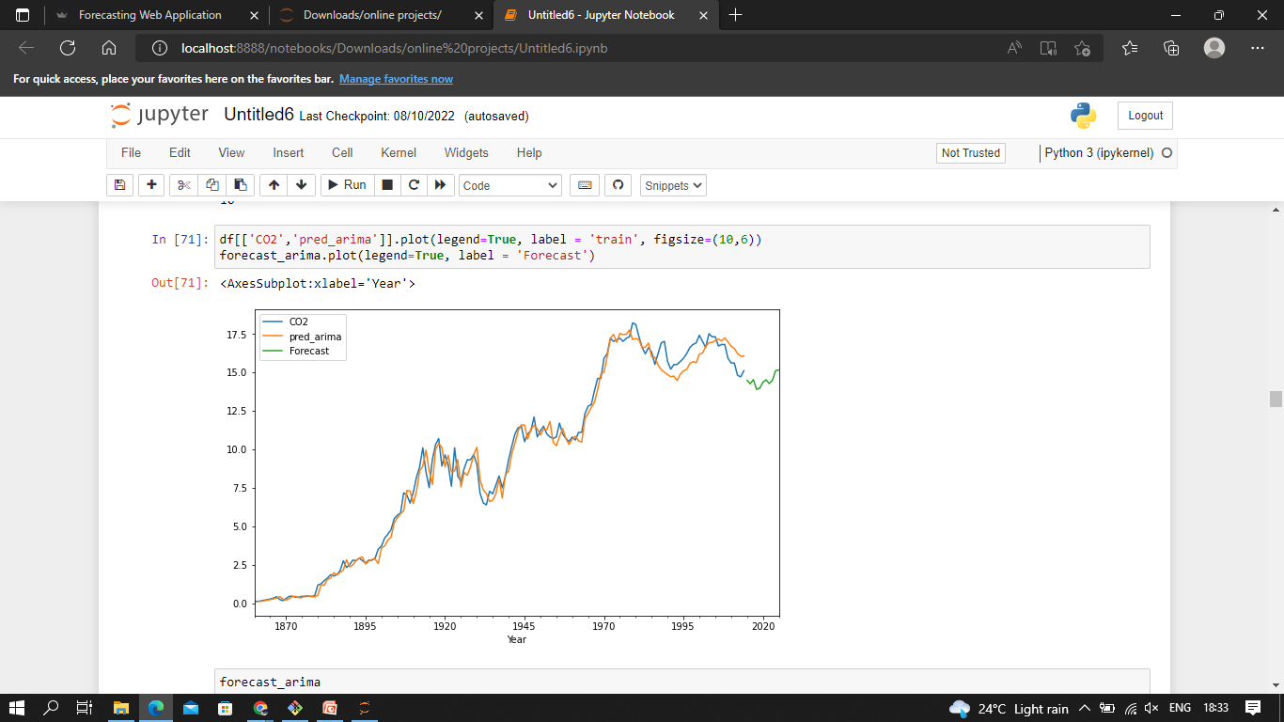
Results from ARIMA (15,1,5)

Slide 19
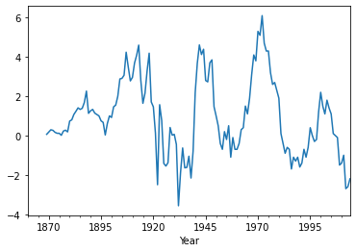
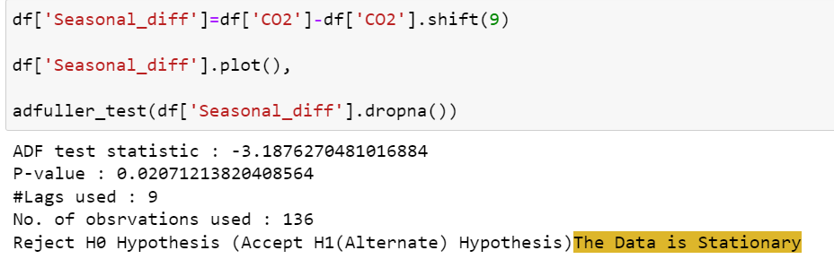
SEASONAL ARIMA: Order = (5,1,3,9)
Stationarity Check:
Series tends to have constant mean and variance over time.
No trend, No seasonality observed

Slide 20
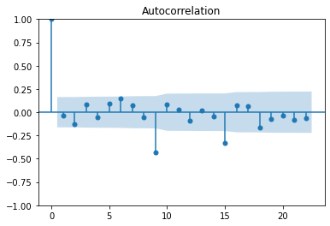
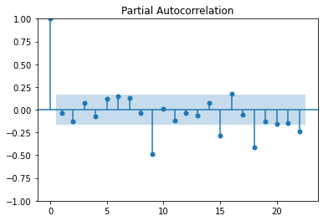
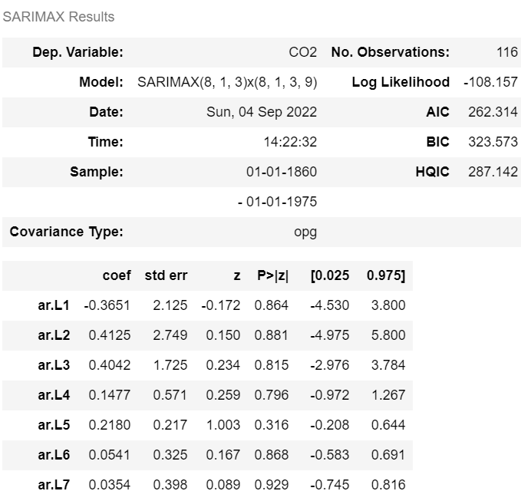
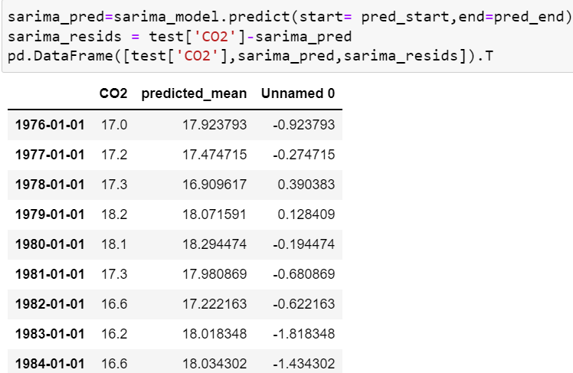
ACF and PACF Plots
By observing the ACF and PACF plot we decided to go for SARIMA of order (8,1,3)
Predicted values of SARIMA(8,1,3)

Slide 21
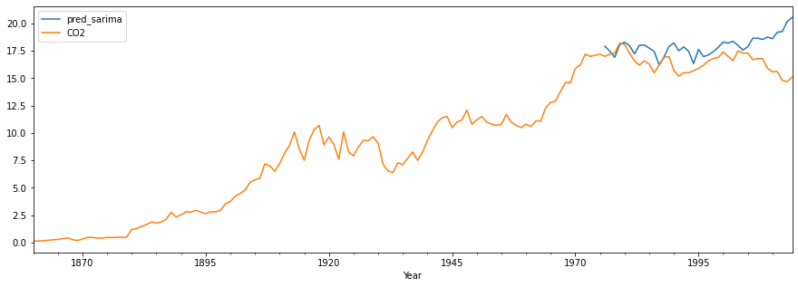
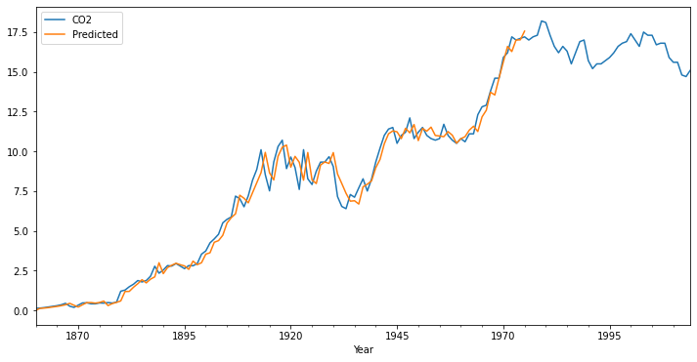
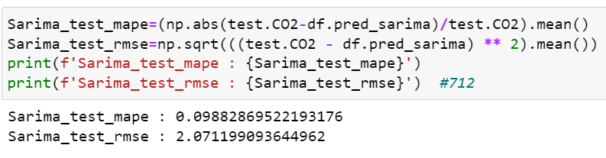
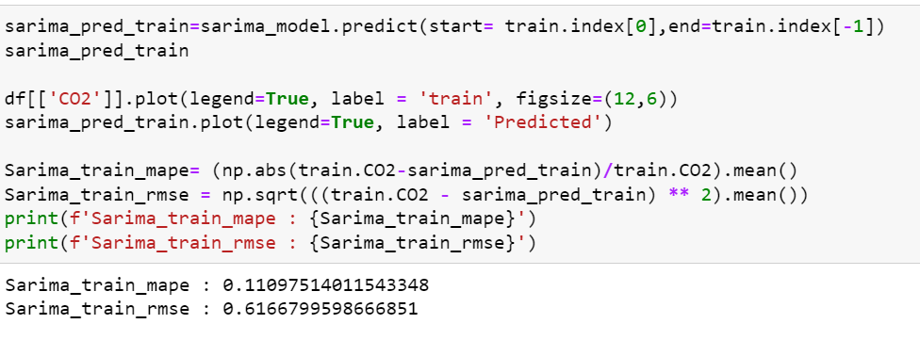
Plots and Accuracy measures:
Test Data
Train Data

Slide 22
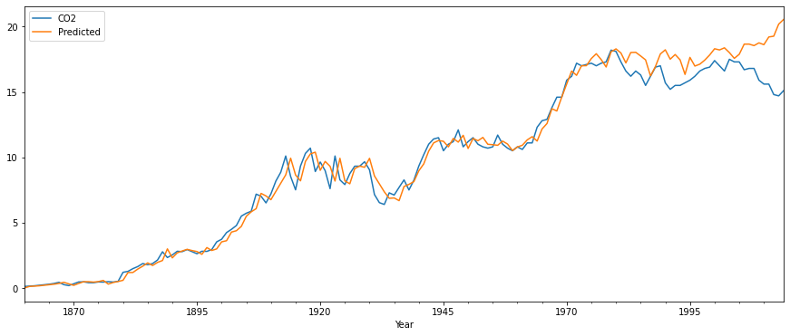
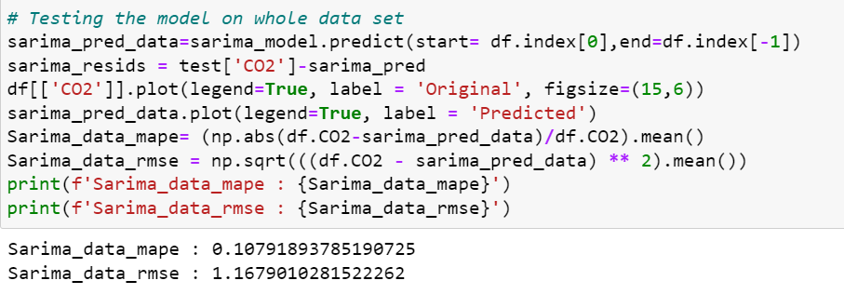
Fit the model on the whole data:

Slide 23
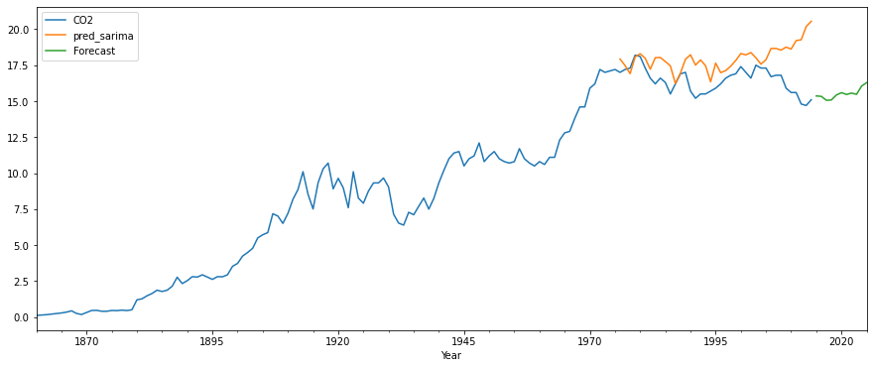
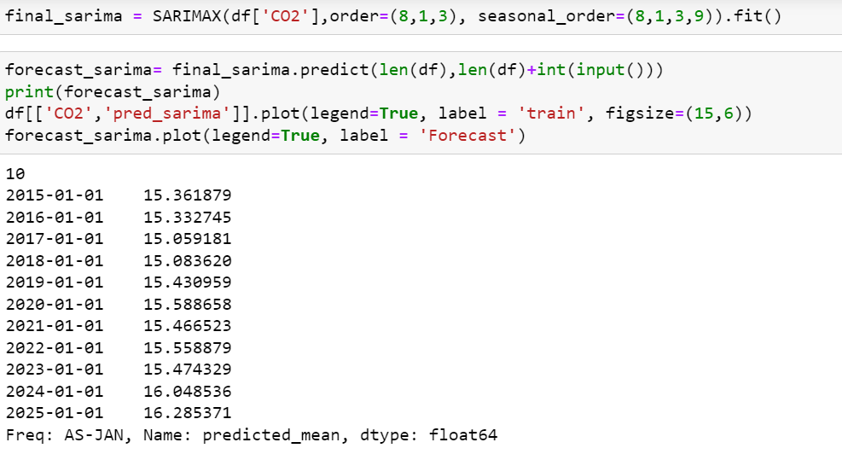
Predict 10 years forecast using this model

Slide 24
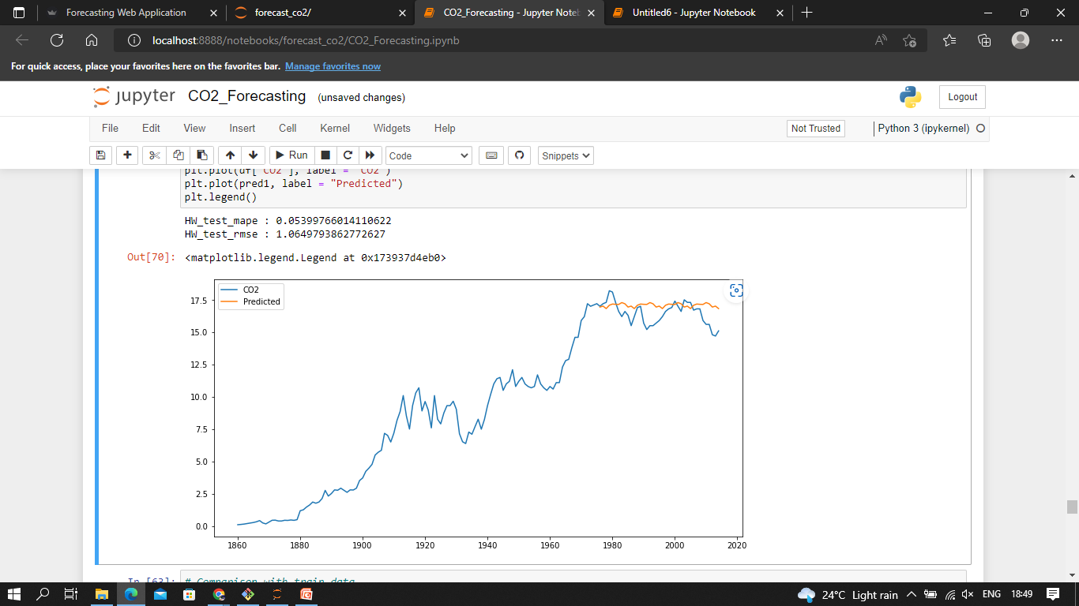
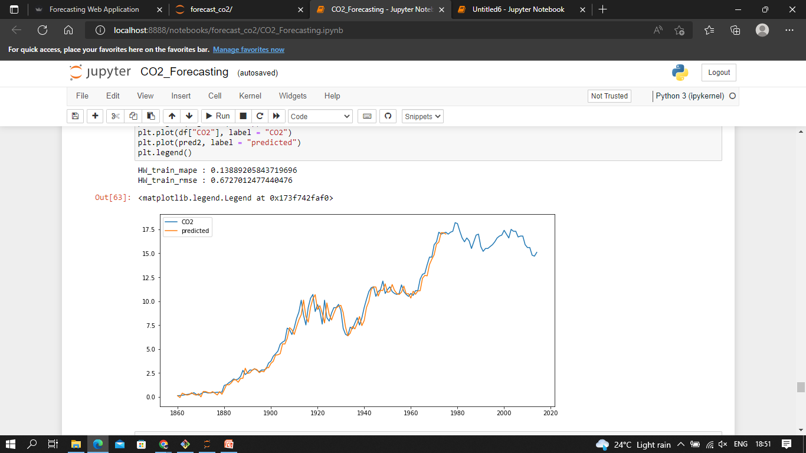
Holt-Winter Model:- seasonal= "add", trend=None , seasonal_periods =9

Slide 25
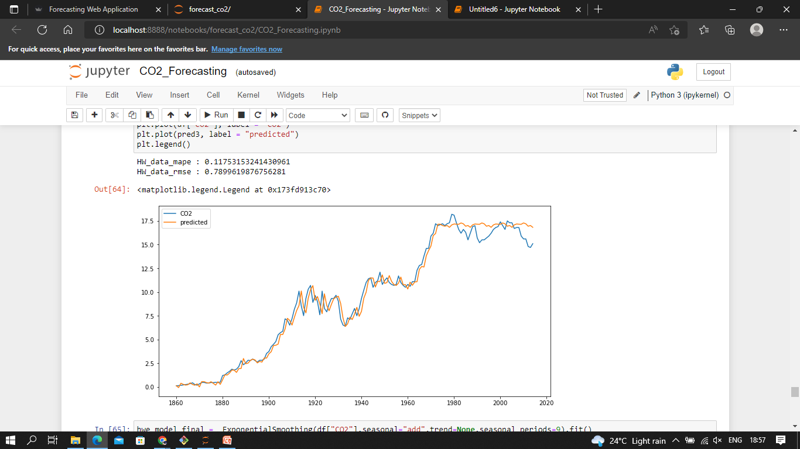
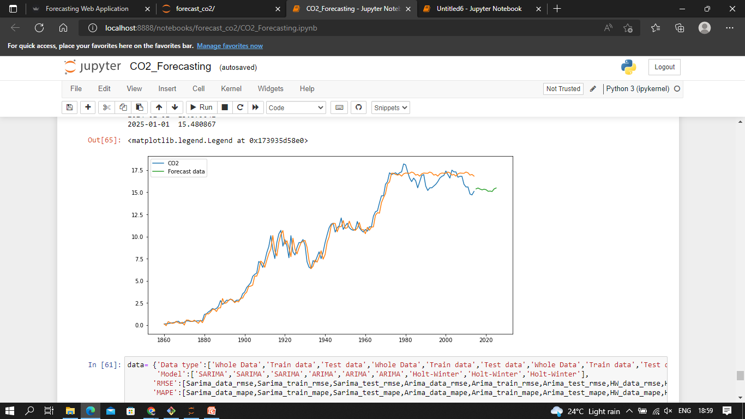
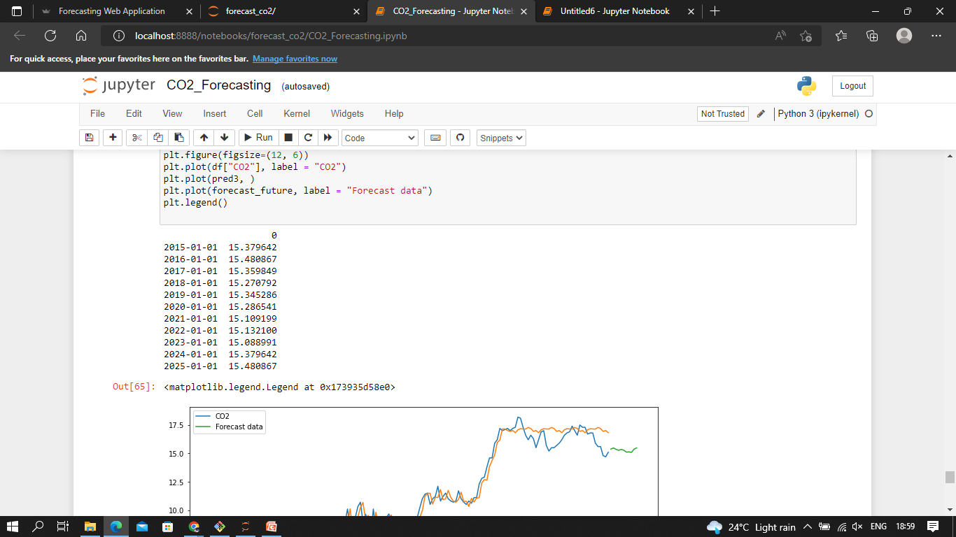
Holt-Winter Model
CO2 Future values forecasted by Holt-Winter Model

Slide 26
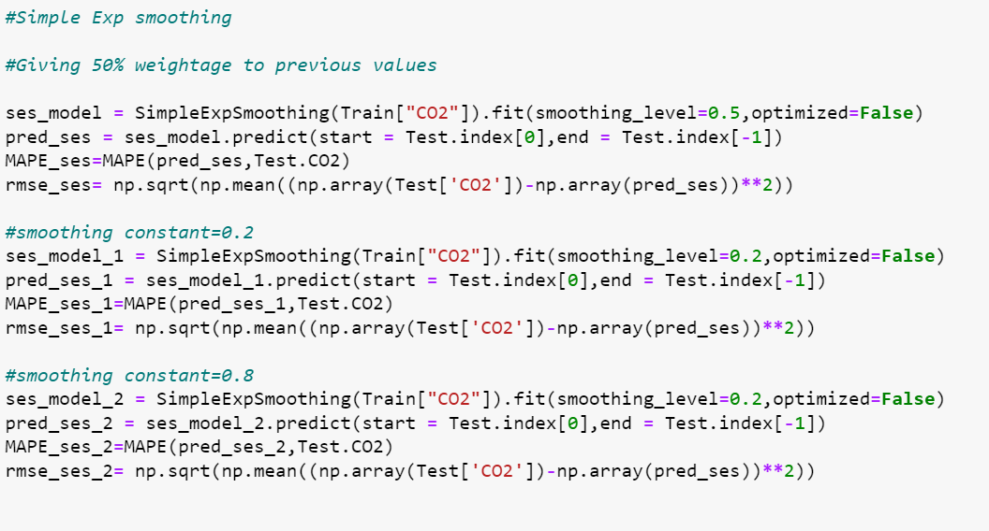
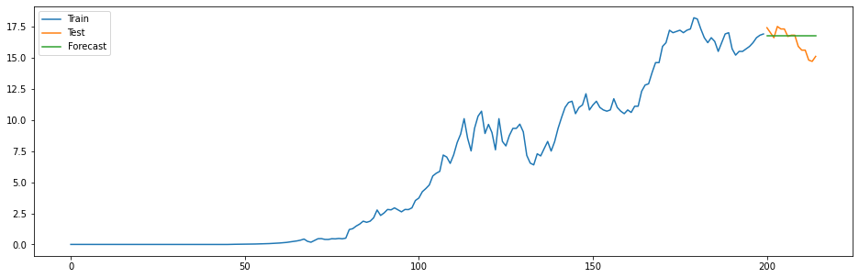
Other Exponential Models Used
Single Exponential Smoothing with alpha=0.2,0.5,0.8

Slide 27
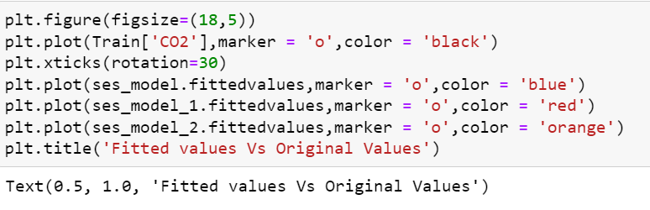
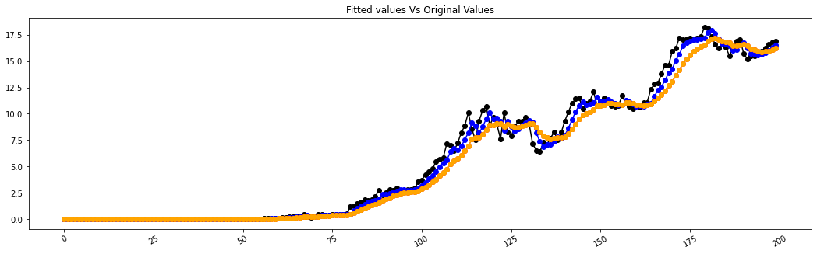
Other Exponential Models Used
Single Exponential Smoothing with alpha=0.2,0.5,0.8
With alpha 0.5
MAPE=8.74
RMSE=1.80

Slide 28
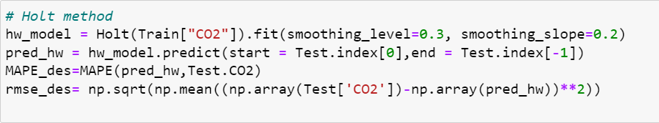
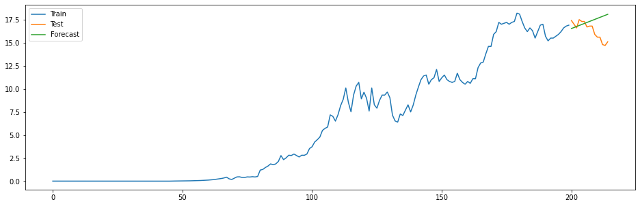
Other Exponential Models Used
Double Exponential Smoothing with alpha=0.3,beta=0.2
MAPE=5.03
RMSE=1.01

Slide 29
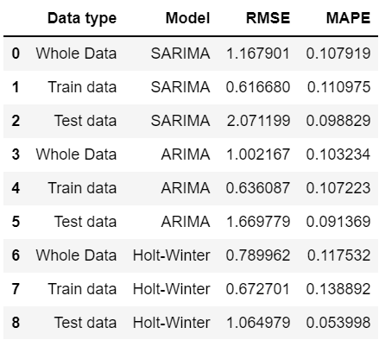
Comparison of the results:

Slide 30
Selection of Final Model for Deployment
Based on the model performance, parameters, RMSE and MAPE, the following models are finalised for deployment
1. ARIMA Model (7,1,2)
2. HW Model (Trend = None , Seasonality = Additive)

Slide 31
Deployment Details:
ARIMA and Holt’s-Winter models are finalised for deployment.
Streamlit Cloud is chosen for deploying the app
The user can select a model and the forecast period to display the results
The graph displays the historical data as well as forecasted data
RMSE and MAPE values can also be displayed on the screen
The forecasted values are also tabulated in the display.

Slide 32
STEPS IN DEPLOYMENT
The finalised and fitted model is saved as .pkl file using pickle library.
Python script file is prepared and stored as .py file
The dependency libraries are written in a text(.txt) file which named as requirements file.
All the above files namely .ipynb, .sav, .pkl, .txt and .py files are stored in GitHub repository
The user account is created and in streamlit share website from where the app can be launched by mentioning the GitHub Repository URL.

Slide 33
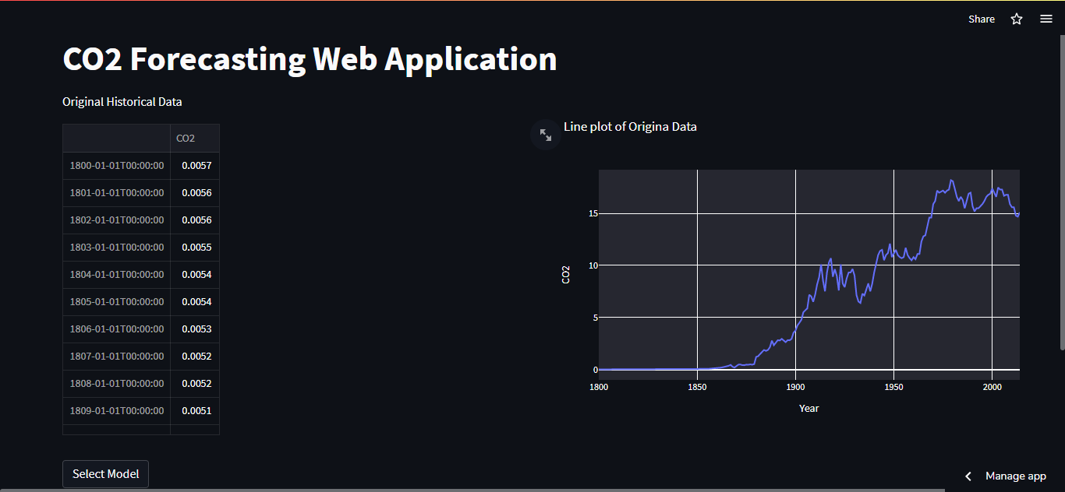
Deployment Screenshots

Slide 34
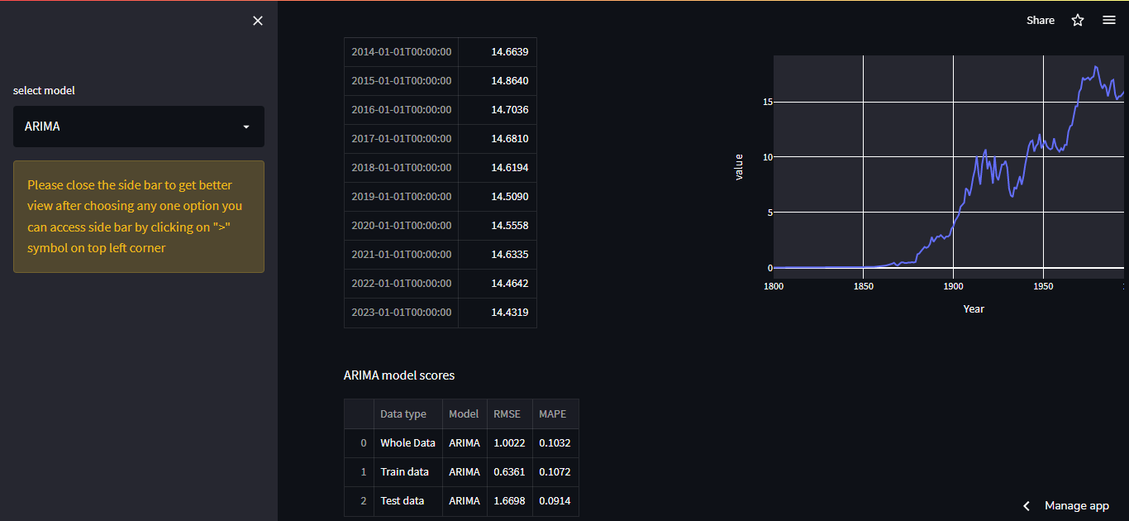
Deployment Screenshots

Slide 35
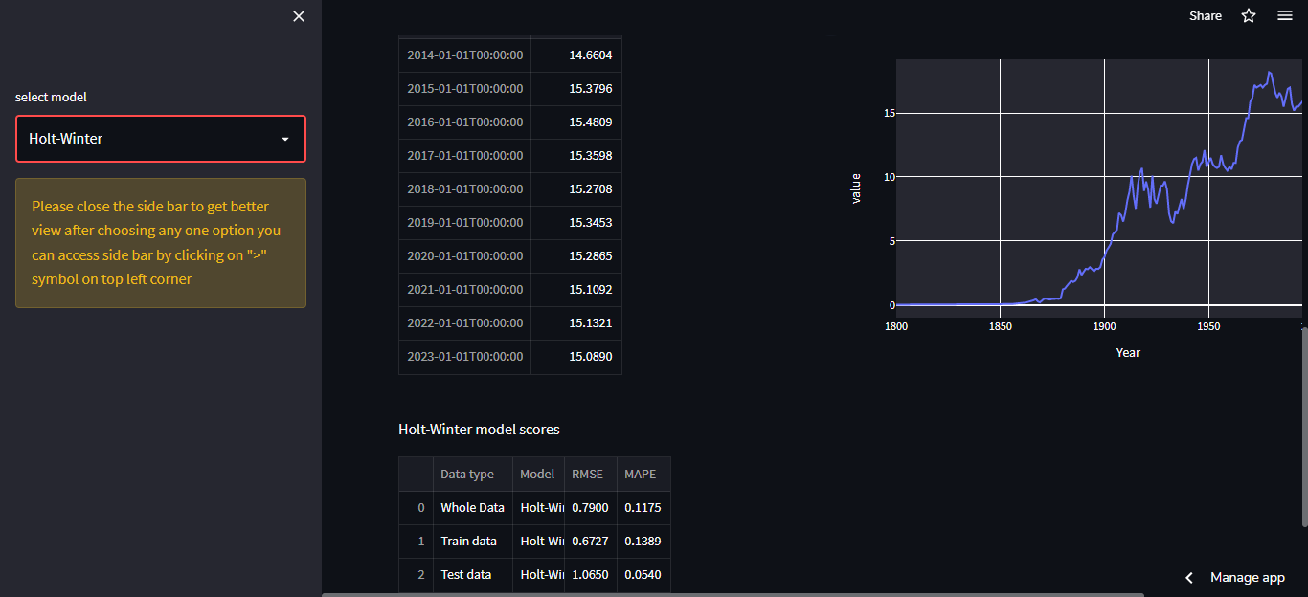
Deployment Screenshots

Slide 36
GitHub Links
https://github.com/srikommareddy/Forecasting-CO2.git
https://github.com/MallikarjunaReddy448/co2-forecasting
https://github.com/AbiramiRangaraj
https://github.com/Simyvazhakunnathu

Slide 37


